Slide 1

SRI BALAJI UNIVERSITY SCHOOL OF COMPUTER STUDIES
A MINI PROJECT ON VEHICLE SERVICING SYSTEM
Submitted By: - SUMIT KUMAR [MCA2302105]
UNDER THE GUIDANCE OF
Prof Akash Bhattacharya

Slide 2
Introduction to Vehicle Servicing System
Aim: Simplify vehicle servicing using an online system.
Benefits: Easy scheduling, digital records, online payments.

Slide 3
Purpose and Scope
Purpose: To save time and reduce stress for vehicle owners and service centers.
Scope: Covers booking, tracking, servicing history, and feedback.

Slide 4
Advantages of the System:
Easy Scheduling.
Real-time service updates.
Digital service history.
Predictive maintenance and more.

Slide 5
Functional Requirements:
User registration.
Appointment scheduling.
Real-time servicing tracking.

Slide 6
Technology Used:
Frontend: HTML, CSS, JavaScript.
Backend: PHP, MySQL.
Database Management: MySQL.

Slide 7
Workflow:
Team roles in gathering requirements, system design, development, testing and deployment.
Estimated time for project completion:~8 months.

Slide 8
Project Overview
This system “Vehicle service management system (VSMS)” allows providing vehicle for service. If customer got any problem with his vehicle they are providing services
The real power of this project lies not in direct selling of products, but in the creation of tighter relationships with customers and delivering of a high level of service and support, which in turn improves organization sales and its goodwill. A service organization is a business entity that takes care of servicing a customer instrument in the after sales domain.
This project contains 2 modules namely :-
User Module,
Admin Module

Slide 9
Admin Module
Secure admin login system
Dashboard: In this section admin can see all detail in brief like total registered user, Total Enquiry, Total Mechanics and Total Services.
Mechanics: In this section admin can manage mechanics (add,delete, and update).
Vehicle Category: In this section admin can manage vehicle category (add,delete and update).
Reg Users: In this section admin can view user detail and update user detail.
Service Request: In this section admin can add service prices (service charge, parts charge additional (if any)). Admin can view services on the basis of status (pending services, rejected services and complete services). Admin also can approve pending policy
Customer Query: In this section admin can respond the customer query and also view the customer responded query and non-responded query.
Enquiry Search: In this section admin can search enquiry with help of customer phone number, email id or contact number.
Service Search: In this section admin can search services with help of customer phone number, email id or contact number.

Slide 10
User Module
Users
1. Dashboard: In this section , User can view the total, rejected, completed services.
2. Enquiry: In this section user can fill the enquiry form and check his query is respond or not (which is done by admin).
3. Service Request: In this section user can fill the service form, check his/her service status and what amount is taken for service and also print his/her amount slip (which is done by admin).
User can also update his/ her profile, change password and recover password.

Slide 11
Requirement Specification
Hardware Configuration:
Client Side
Server Side
RAM | 512 MB
Hard Disk | 10GB
Processor | 1.0 GHz
RAM | 1 GB
Hard Disk | 20GB
Processor | 2.0GHz

Slide 12
Continue.....
Software Requirement:
Client Side
Server Side
Web Browser | Google Chrome or any compatible browser
Operating System | Windows or any equivalent OS
Web Server | APACHE
Server side Language | PHP5.6 or above version
Database Server | MySQL
Web Browser | Google Chrome or any compatible browser
Operating System | Windows or any equivalent OS

Slide 13
Use Case Diagram
Notes:
USECASE DIAGRAM: A Use case is a description of set of sequence of actions. Graphically it is rendered as an ellipse with solid line including only its name. Use case diagram is a behavioral diagram that shows a set of use cases and actors and their relationship. It is an association between the use cases and actors. An actor represents a real-world object. Primary Actor – Sender, Secondary Actor Receiver.

Slide 14
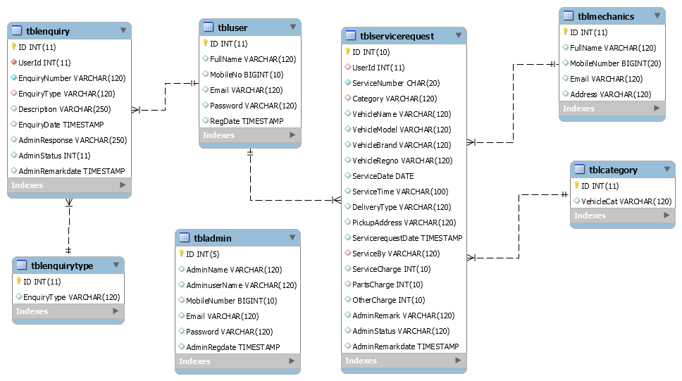
Class Diagram
Notes:
Class Diagram:
A description of set of objects that share the same attributes operations, relationships, and semantics

Slide 15
ER Diagram

Slide 16
Data Flow Diagram
A data flow diagram is graphical tool used to describe and analyze movement of data through a system. These are the central tool and the basis from which the other components are developed. The transformation of data from input to output, through processed, may be described logically and independently of physical components associated with the system.
These are known as the logical data flow diagrams. The physical data flow diagrams show the actual implements and movement of data between people, departments and workstations.

Slide 17
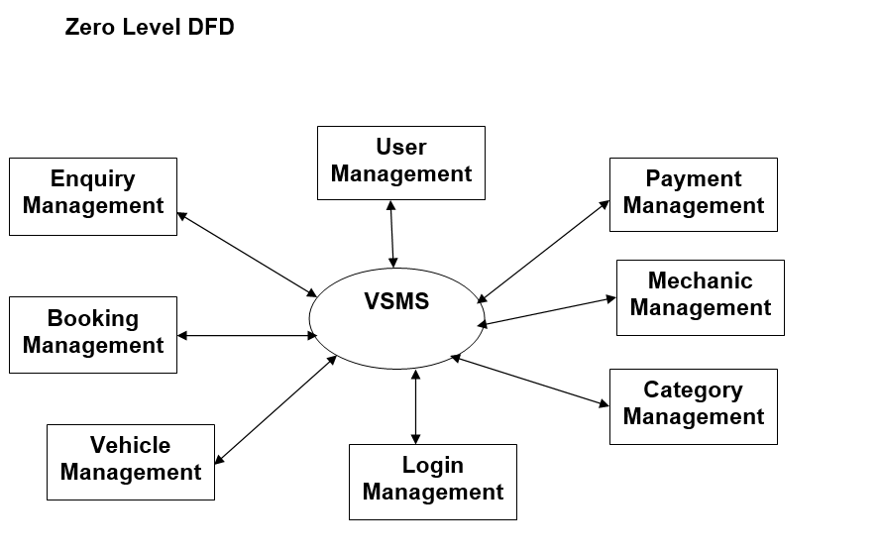

Slide 18
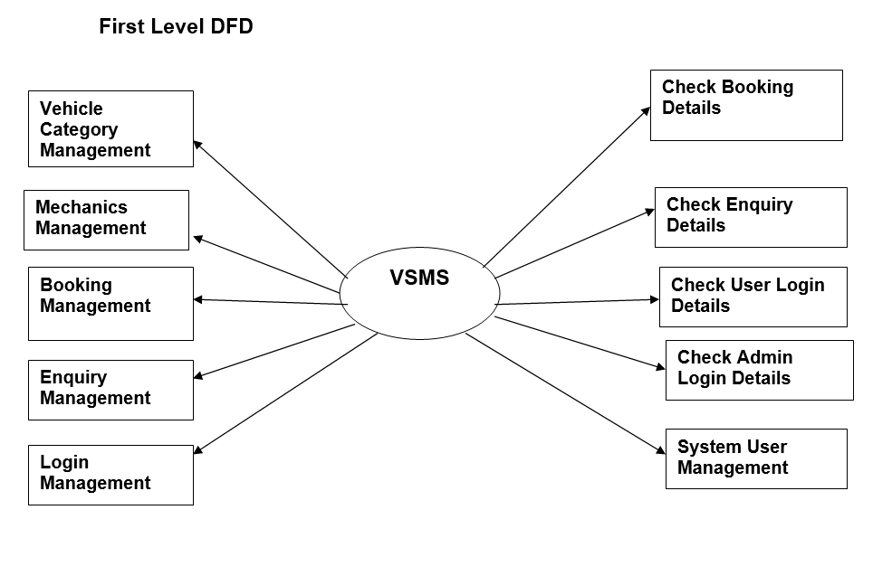

Slide 19
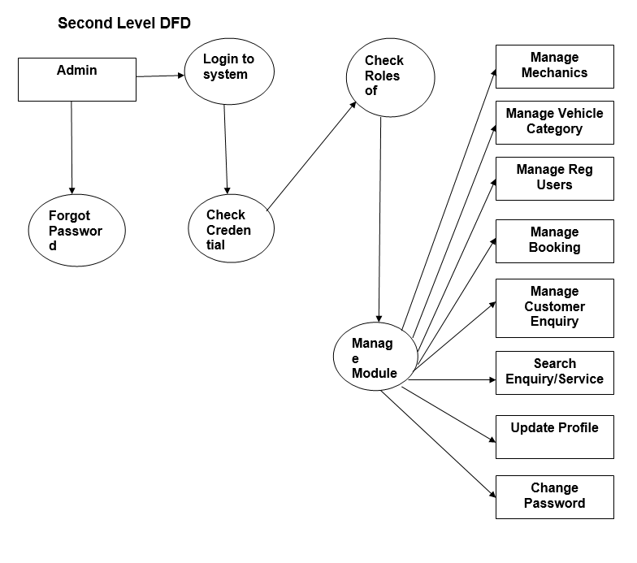

Slide 20
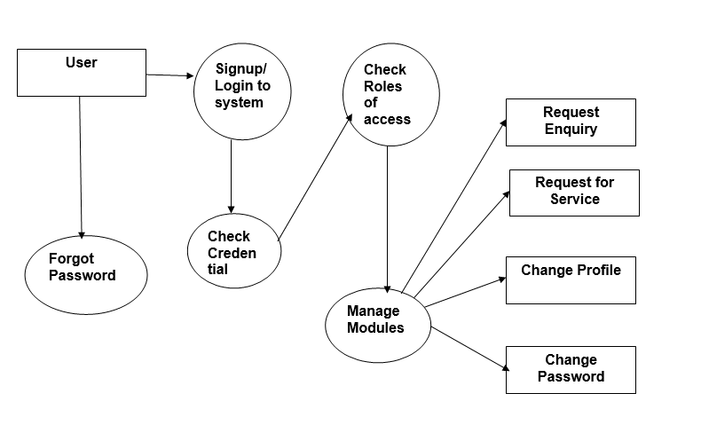

Slide 21
Implementation and System Testing
After all phase have been perfectly done, the system will be implemented to the server and the system can be used.
System Testing
The goal of the system testing process was to determine all faults in our project .The program was subjected to a set of test inputs and many explanations were made and based on these explanations it will be decided whether the program behaves as expected or not. Our Project went through two levels of testing
Unit testing
Integration testing

Slide 22
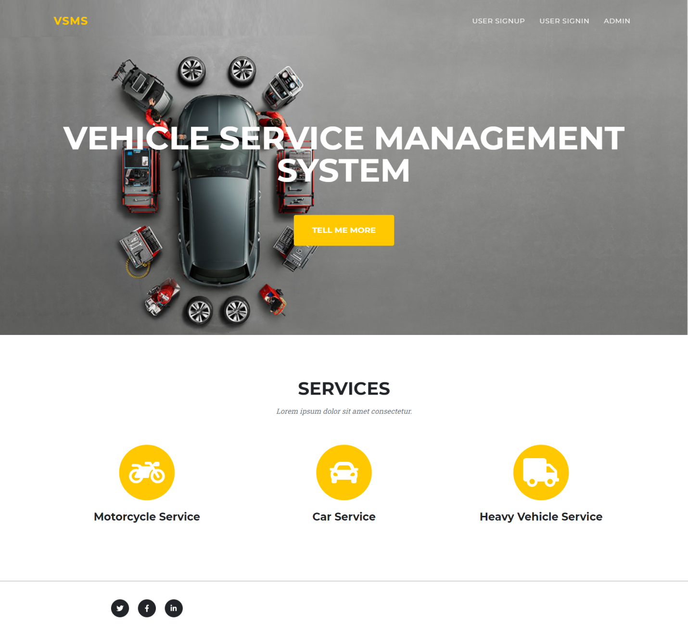
Project Screens

Slide 23
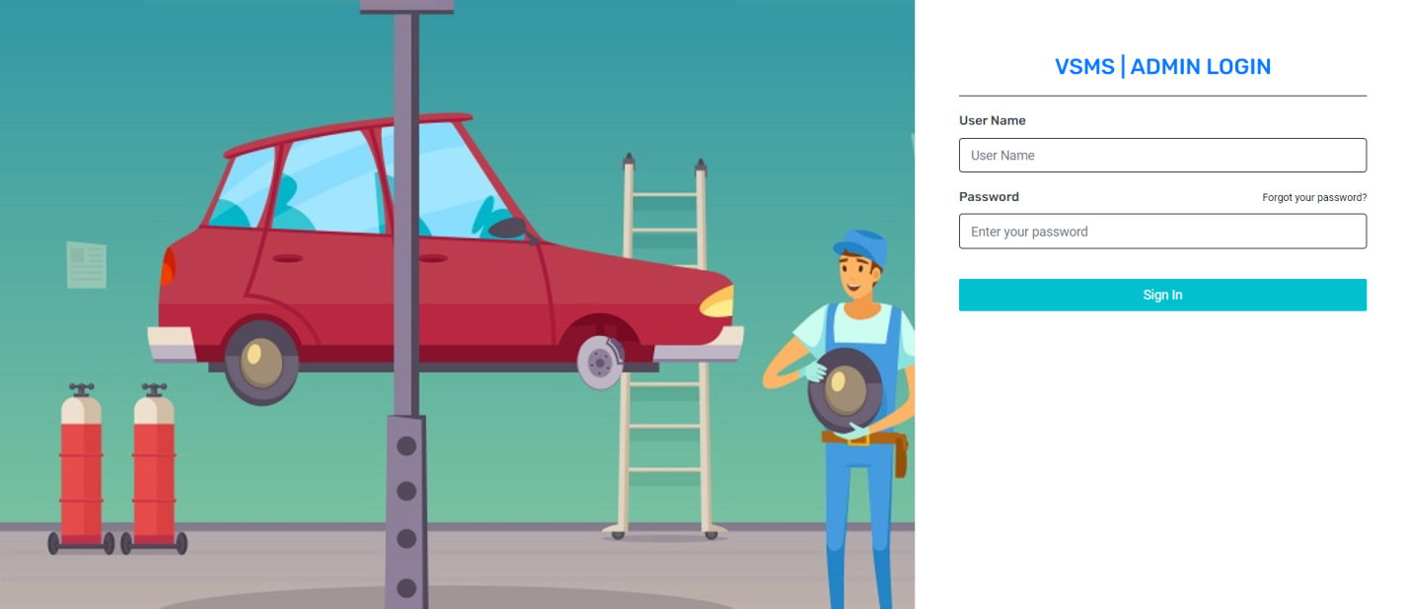
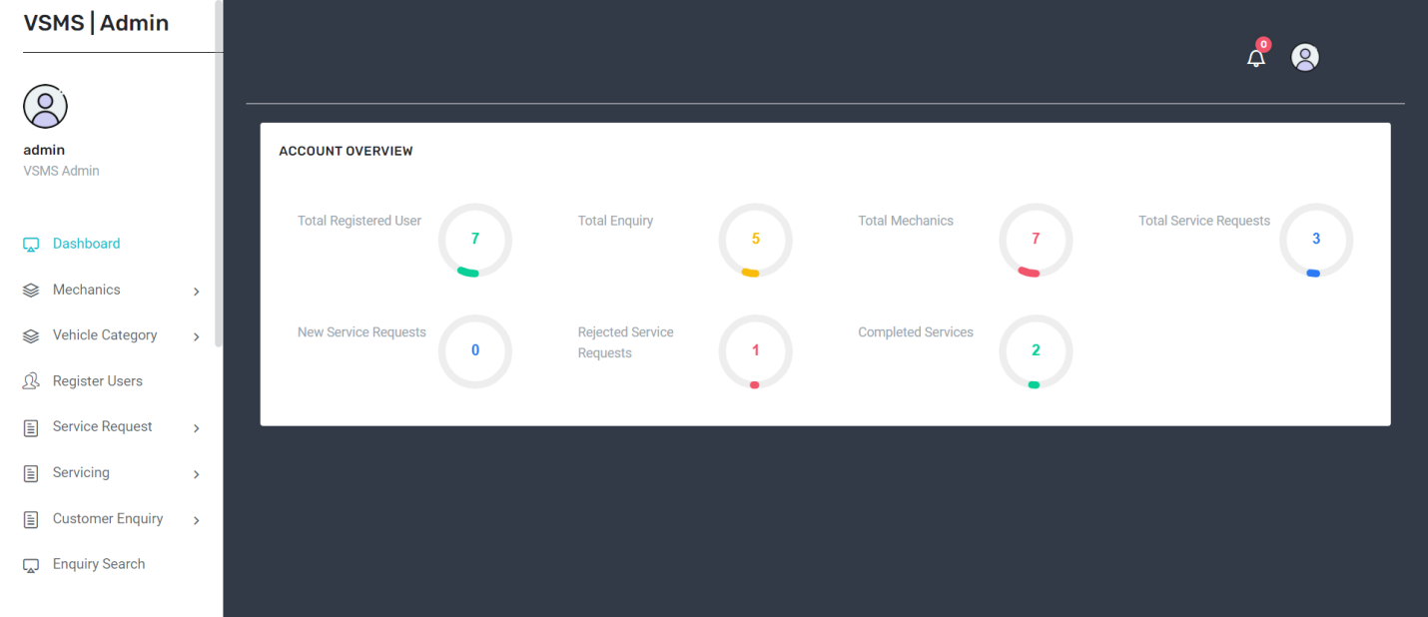

Slide 24
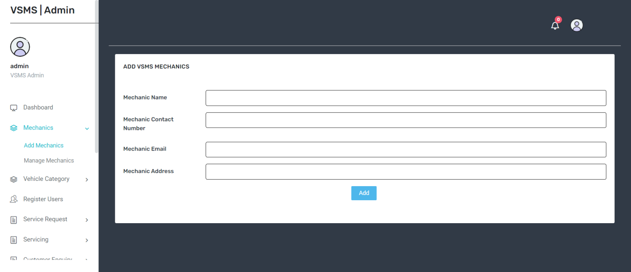
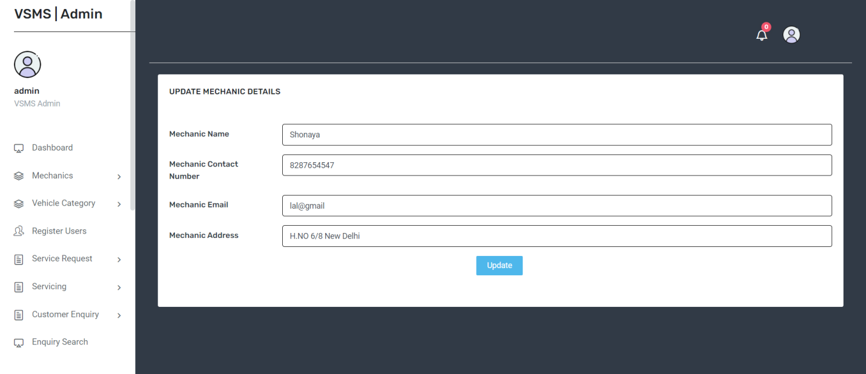

Slide 25
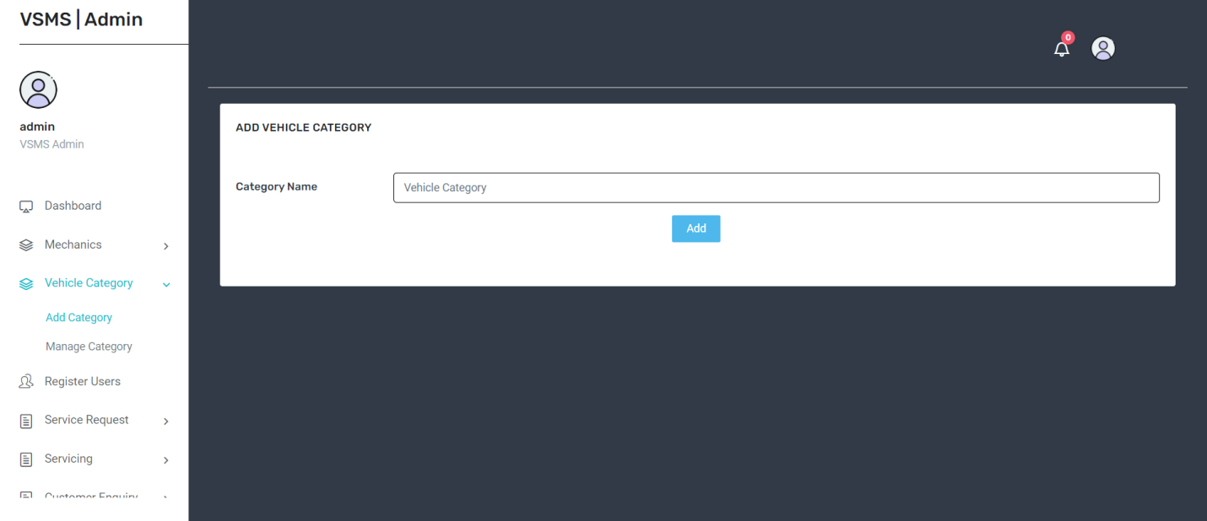
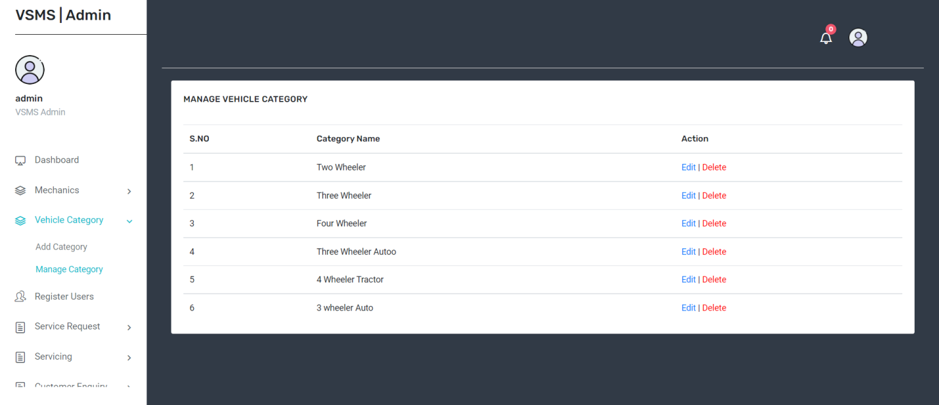

Slide 26
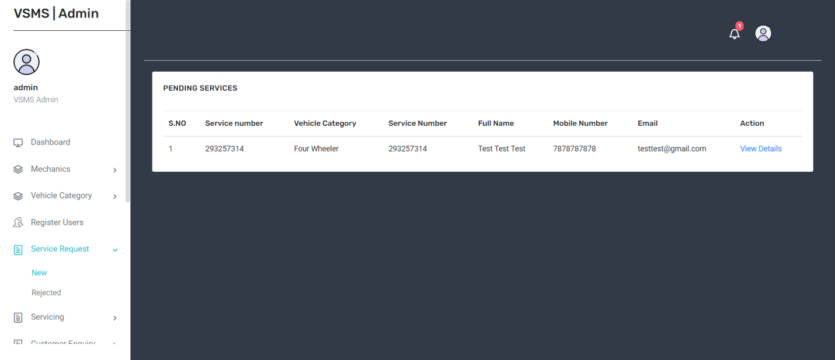
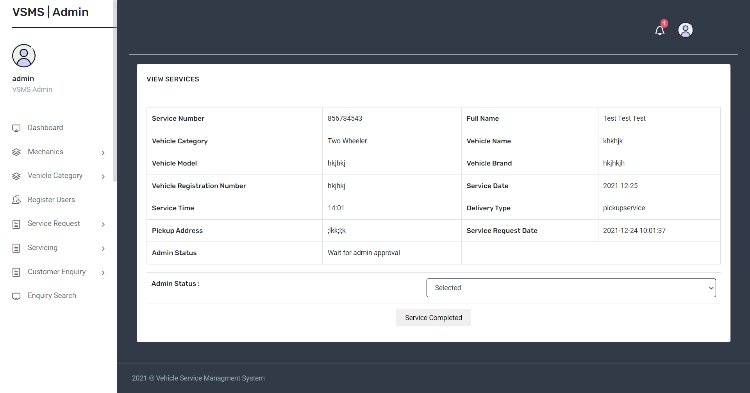

Slide 27
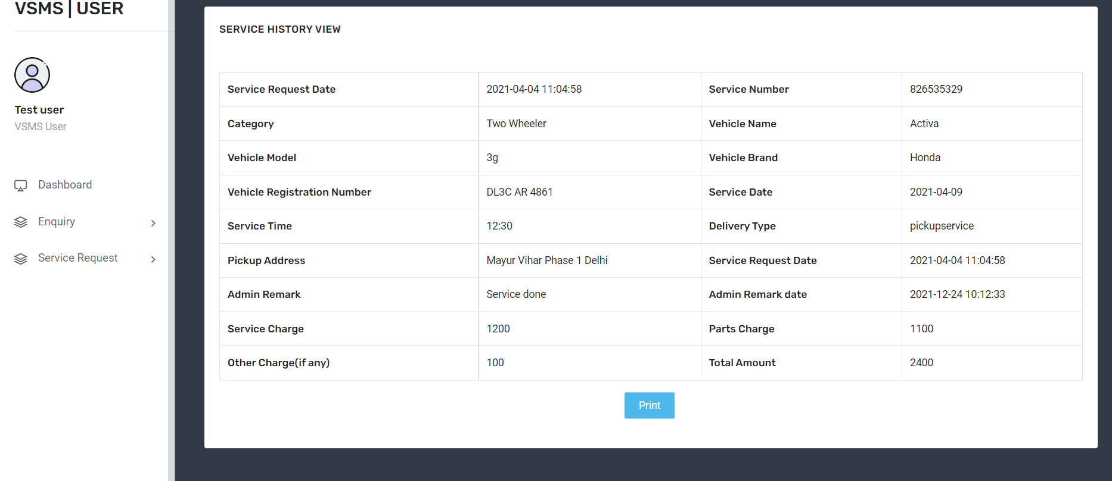

Slide 28
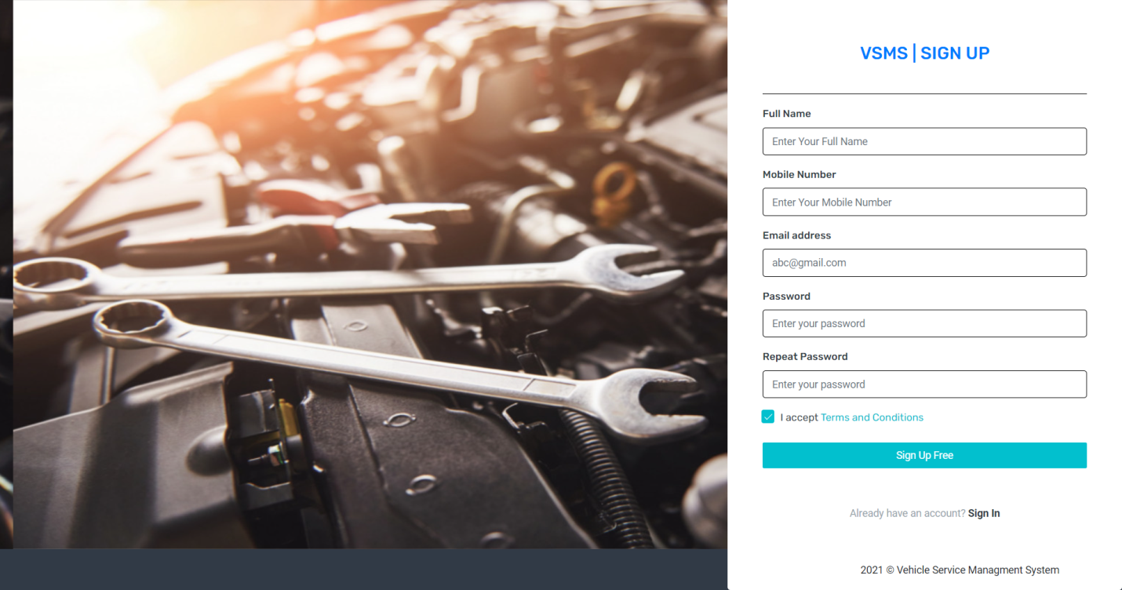
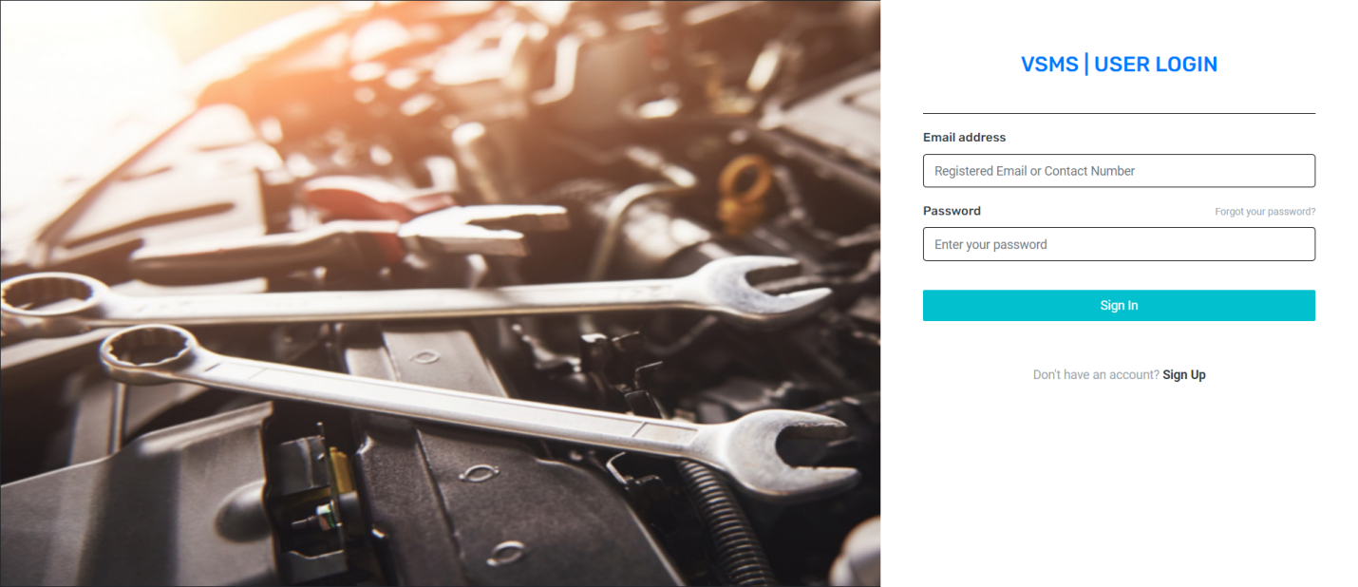

Slide 29
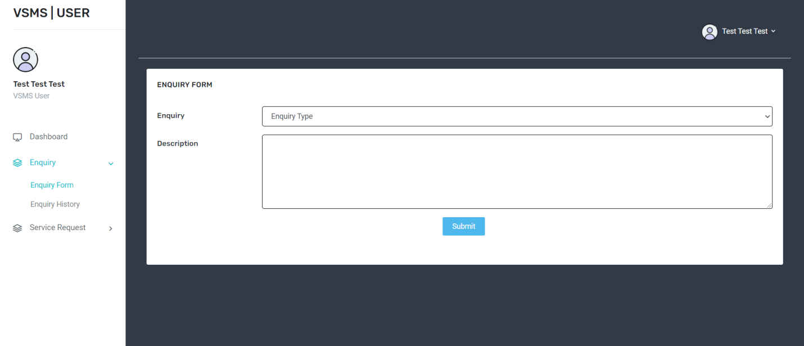
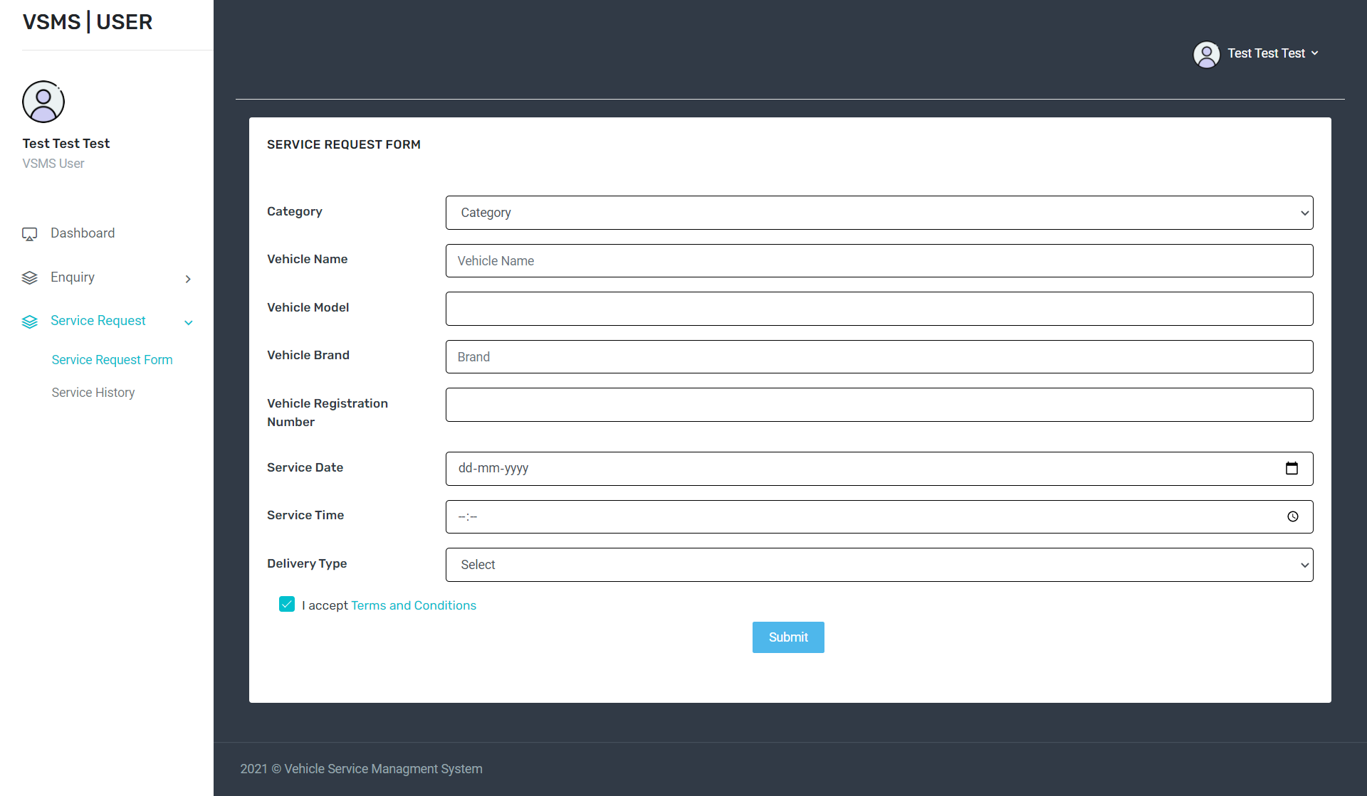

Slide 30
Conclusion
The package was designed in such a way that future modifications can be done easily. The following conclusions can be deduced from the development of the project.
Automation of the entire system improves the efficiency
It provides a friendly graphical user interface which proves to be better when compared to the existing system.
It gives appropriate access to the authorized users depending on their permissions.
It effectively overcomes the delay in communications.
Updating of information becomes so easier.
System security, data security and reliability are the striking features.
The System has adequate scope for modification in future if it is necessary.

Slide 31
References
For PHP
https://www.w3schools.com/php/default.asp
https://www.sitepoint.com/php/
https://www.php.net/
For MySQL
https://www.mysql.com/
http://www.mysqltutorial.org
For XAMPP
https://www.apachefriends.org/download.html

Slide 32
Thank You

